Slide 1
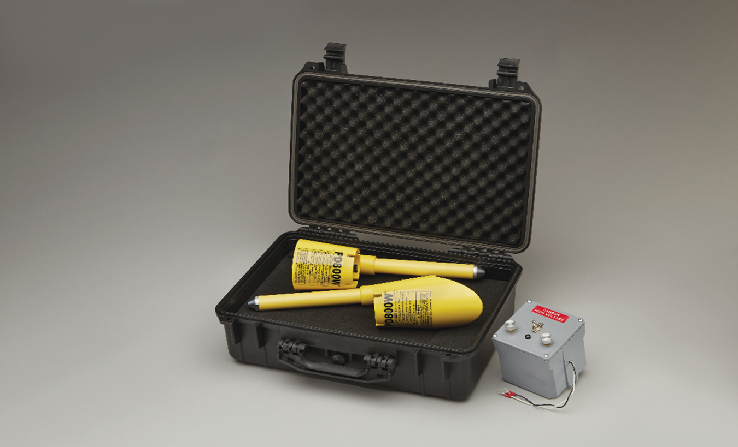


PD800W
CORDLESS PHASING TESTER

Slide 2
OVERVIEW
Theory of Operation & Principles
Introduction to the PD800W
Equipment Overview/Specifications
Procedures
Features

Slide 3
Theory of Operation & Principle
In the “DEG” switch position, the PD800W compares the Phase Angle between the Reference Probe and the Meter Probe in Real-Time.
The resultant between the two measurements is displayed as a numerical number in Degrees on the Meter Probe and as LED lights (White, Blue, Red) below the number.
In the “URD” (Underground Residential Distribution) or “OH” (Overhead) switch position, the PD800W compares the Phase Angle between the Reference Probe and the Meter Probe in Real-Time and simultaneously displays a nominal voltage relationship (Phase-to-Phase) as well as the LED lights (White, Blue, Red) below the number.

Slide 4
Specifications
Accuracy
  Degrees, ± 2%, + 2 counts
  Voltage, +/- 30% based on ASTM Standard F1796
Digital Display
  Bright LED Display
  1.00” Digits
Operating Distance
  100ft. to 300ft. line-of-sight
Operating Frequency
  916.48mHz (FCC Compliant)
Housings molded from high impact ABS plastic and incorporates water resistant construction.
Replaceable 9V internal battery located behind live-line tool fitting.

Slide 5
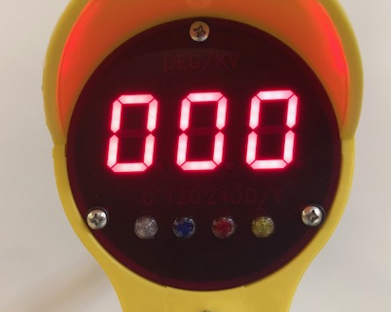
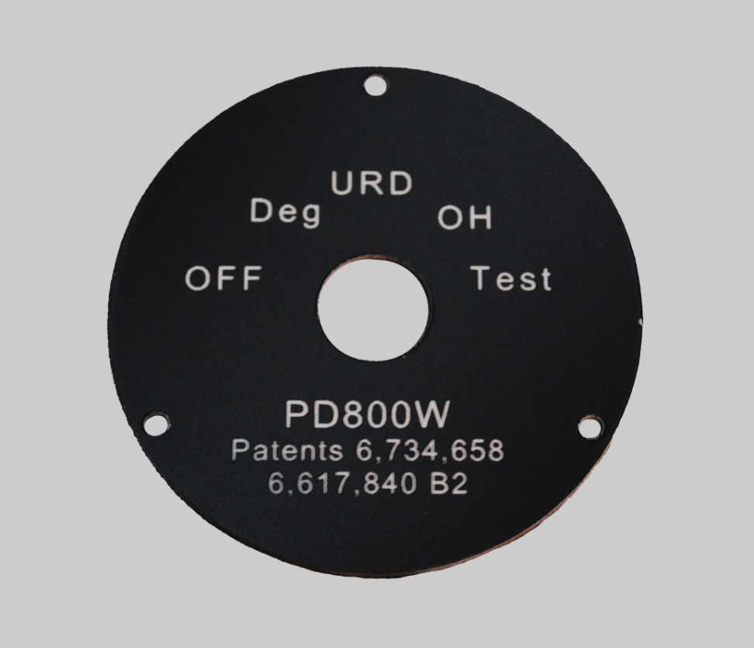


Equipment Overview
Meter Probe
Five Position Switch
Delta/Wye Light
240 Degree Light
120 Degree Light
0 Degree Light
Phase Angle Display

Slide 6
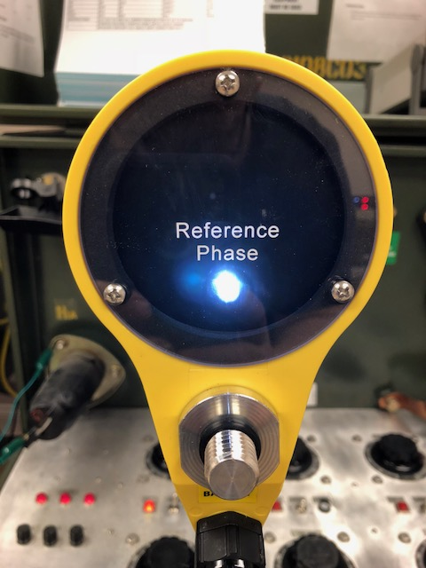

Equipment Overview
Reference Probe
Five Position Switch
The White LED on the Reference Probe will be “ON” if the voltage or electrical field is equal to or greater than the threshold values below:
DEG Switch Position 30VAC
URD or OH Switch Position Approx. 300VAC

Slide 7
Equipment Overview
Selector Switch Position and Function
“OFF” – Unit is off for storage or transit.
“DEG” – For Phase Angle measurements (all traditional phasing applications) between the Meter Probe and Reference Probe on 3-Phase Secondary, URD, Overhead/Transmission systems. Make direct contact from capacitive test points to 69kV Phase-to-Ground. Non-Contact (minimum approach distances) for any voltages above 69kV Phase-to-Ground.
“URD” – For nominal voltage readings in URD systems or applications 10ft. or less above Earth. Direct contact from 4kV to 51kV, not for use on capacitive test points.
“OH” – For nominal voltage readings in Overhead systems or applications 20ft or higher above Earth. Direct contact from 4kV to 51kV.
“TEST” – Performs an internal self-test (displays “510”), also displays approximate internal battery voltage, i.e. 080 = 8VDC.

Slide 8
Equipment Overview
Meter Probe Phase Lights Indications
Note: The Meter Probe colored lenses (White, Blue, Red) can be manually moved or swapped with other lenses to display or coordinate the color sequence per the Utilities preference.
Example:
Instead of a White, Blue, Red (OEM) sequence, a Utility can make the sequence Blue, White, Red or Red, White, Blue, etc.
0° – Indicates an In-Phase condition
120°– Indicates an Out-of-Phase condition of 120°.
240° – Indicates an Out-of-Phase condition of 240°.
D/Y – Indicates a Delta/Wye transformation, i.e. +/-20° phase shift in conjunction with one of the other three phase LED lights.

Slide 9
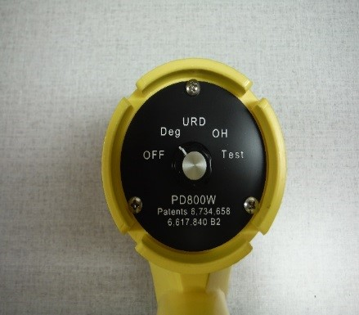
Procedures
Perform a self-test with the Meter Probe, verify Meter displays a “510” (+/- 2 counts) in each switch position and battery voltage is 7VDC or higher. Leave Meter Probe in either the URD or OH switch position to test Reference Probe.
Perform a self-test with the Reference Probe, verify Meter Probe displays a “510” (+/- 2 counts) in each switch position and a battery voltage of 7VDC or higher from the Reference Probe.
Note: Turn both the Reference Probe and Meter Probe to the same selector switch position before testing.

Slide 10
Procedures
Attach the appropriate live-line-tool fitting for the voltage potential to be tested.
Bierer & Associates highly recommends both the Meter and Reference Probe perform a test on a “known” voltage source such as our 2-Phase Power Supply (part# T2) or an equivalent source before and after each use.
Always hold the Reference Probe and Meter Probe
perpendicular (as possible) to the conductor being tested and
away from all other conductive surfaces a minimum of two (2) feet such as:
  Adjacent Phases
  Neutrals
  Grounded structures
  Yourself
Note: Keep the Reference and Meter Probe housings away from each other a minimum of two (2) feet.
*****For Voltage measurements skip to page #16****

Slide 11
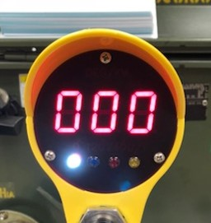
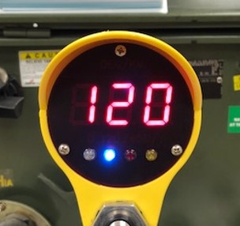
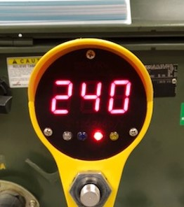
Procedures
  While in the DEG switch position make
  Direct Contact from 208V-to-69kV, see images below as an example of readings.
  - Including Capacitive Test Points
  Non-Contact from 69kV-to-800kV.
  - Distance from conductor can be equal to or greater than minimum
  approach distance for voltage being tested.
  - On lines 115kV-to-600kV, the Reference probe may be suspended from
  the conductor with the optional insulated support hook attachment
  PD800SH2 or PD800SH4.
Nominal 0°
and the White
phase LED is on
Nominal 120°
and the Blue
phase LED is on
Nominal 240° and the Red phase LED is on

Slide 12
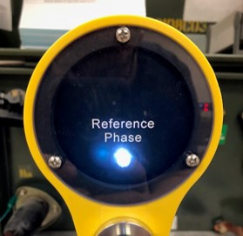
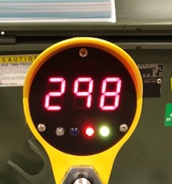
Procedures
(Continued) Step #7, if the Meter Probe reading is not one of or near the nominal 3-Phase readings, i.e. 0°, 120°, 240° and some multiple of 30° as demonstrated in the image below right, then the Reference and Meter Probe is phasing across a Delta/Wye transformation.
A blinking Yellow “D/Y” light indicates a Delta/Wye transformation (multiple of 30° phase shift) in conjunction with one of the other phase indicator lights.
Note: The White Light on the Reference Probe will always be on if the unit sees at least 30VAC, in direct contact or electrical field. The White Light must be present to ensure proper operation of the PD800W.
The D/Y yellow
LED activates if
the phase angle
deviates +/- 20°
from any one of
the three nominal
readings

Slide 13
Procedures
With both Probes still in the DEG switch positions, test phase
sequence.
Note: Phase sequence is the order in which the voltages of a three phase
system rise and fall. Only two sequences are possible, normally referred
to as a “Positive” and “Negative” sequence, or a “Clockwise” and
“Counter-Clockwise” sequence.
However, there are three different physical connections as demonstrated on the following page, to achieve each sequence. Any one of the phases of a three phase system may be assigned the status of “Leading” phase. This convention is currently left up to the discretion of the electric utility.

Slide 14
Procedures
Testing Phase Sequence
DEG Switch Position
Sequence (A-B-C)(1-2-3)
  A-B-C A-B-C-A-B-CA-B-C
  B-C-A B-C-A-B-C-A-B-C-A
  C-A-B C-A-B-C-A-B-C-A-B
Sequence (C-B-A)(3-2-1)
  C-B-A C-B-A-C-B-A-C-B-A
  B-A-C B-A-C-B-A-C-B-C-A
  A-C-B A-C-B-A-C-B-A-C-B

Slide 15
Procedures
Testing Phase Sequence
DEG Switch Position
9. With both Probes still in the DEG switch positions, test
for phase sequence while using Step #7 criteria.
Touch or approach A(1) phase with the Reference probe
Touch or approach B(2) phase with the Meter probe
Sequence (A-B-C)(1-2-3) will be indicated by a nominal 120° and the Blue LED will be on
Sequence (C-B-A)(3-2-1) will be indicated by a nominal 240° and the Red LED will be on

Slide 16
Procedures
Voltage Readings in the URD or OH Switch Positions
When using both the Meter Probe and Reference Probe or either Probe individually, to display voltage in the URD or OH position, the displayed values are a composite of the nominal voltage(s) on the conductor(s) and the capacitive coupling of other potentials (ground or energized) in the vicinity of the Reference and/or the Meter probe.
The following page (page #17) demonstrates how a probe, without a true ground (no ground lead) reference, will capacitively couple with its surrounding environment.

Slide 17
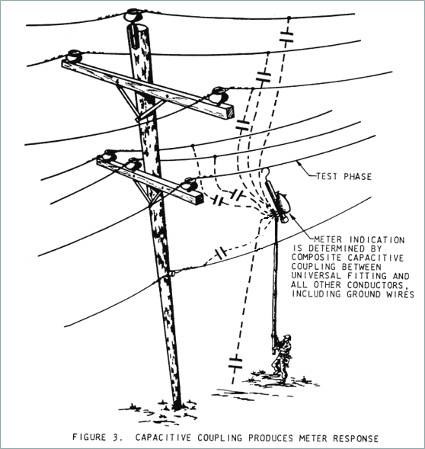
Procedures
Capacitive Coupling Effect

Slide 18
Procedures
Capacitive Coupling Effect
The Phase-to-Phase voltage readings on the Meter Probe is derived from the Phase-to-Ground voltages present on both the Meter and Reference Probes.
The resulting Phase-to-Phase readings will be proportional to the Phase-to-Ground readings.

Slide 19
Procedures
Capacitive Coupling Effect
Higher than nominal readings in the OH position can sometimes be lowered by retesting in the URD position especially when used in close proximity to system neutrals and other grounded surfaces.
Note: The URD and OH positions are height compensated with regards to true earth/ grounded surface as follows;
URD – 10ft. or less
OH - 20ft. or greater

Slide 20
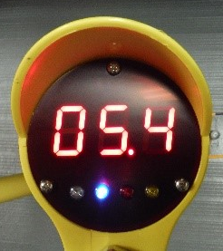
Procedures
Phase-to-Phase Out-of-Phase Voltage Reading
Direct Contact URD and OH – 4kV-to-69kV
Obtained by touching one phase conductor with the Reference Probe and another phase conductor with the Meter Probe

Slide 21
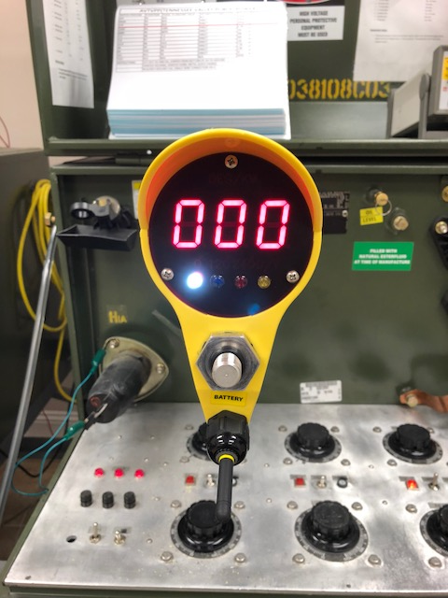
Procedures
Phase-to-Phase In-Phase Voltage Reading
Direct Contact URD and OH – 4kV-to-69kV
Obtained by touching the Reference Probe and Meter Probe to conductors of the same phase

Slide 22
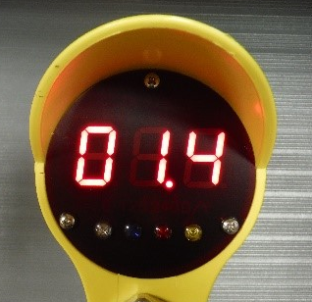
Procedures
Phase-to-Ground Reading
Direct Contact URD and OH - 4kV-to-69kV
Meter Probe or Reference Probe may be used as a stand alone direct contact digital Voltage Detector.
When using the Meter Probe in this manner the Reference Probe must be switched off.
When using the Reference Probe in this manner, the nominal voltage will be displayed on the Meter Probe. Note: Make sure both probes are in the same selector switch position.

Slide 23
Procedures
Reference Probe as a Voltage Detector
Direct Contact Deg, URD & OH – 120V-to-69kV
Obtain reading by touching the energized conductor or capacitive test point. The White LED will be on if the voltage is equal to or greater than the threshold values below:
  Deg position 30V
  URD or OH Approx. 350V

Slide 24
Procedures
Reference Probe as a Voltage Indicator
Non Contact Deg & OH – 69V-to-500kV
Obtain indication by approaching the energized conductor or equipment. The White LED will be on if the voltage is equal to or greater than the threshold values below:
  Deg 30V – Threshold distance is greater than minimum approach distance.
  OH 350V – Threshold distance near minimum approach distance.

Slide 25
Features
PD800W
CORDLESS PHASING TESTER
Saves Money – Less Time
Improves User Safety – No interconnect cable required
Multi-Function 4 Meters in one:
1. Phasing Tool
2. Phase Sequence Indicator
3. Phase Angle Indicator
4. Voltage Detector
Wide Operating Voltage Range:
- 120V-to-800kV

Slide 26
Features
PD800W
CORDLESS PHASING TESTER
Application Flexibility in the Field
Allows Uniformity of Equipment In The Field, Transmission, Substation, Distribution
Requires No Ranging, Multipliers or Extension Resistors, Universally Phases on Any System; Including Capacitive Test Points

